Slide 1
Interleaved Group Convolutions for Efficient Deep Neural Network
Jingdong Wang
Senior Researcher
Microsoft Research, Beijing, China

Slide 2
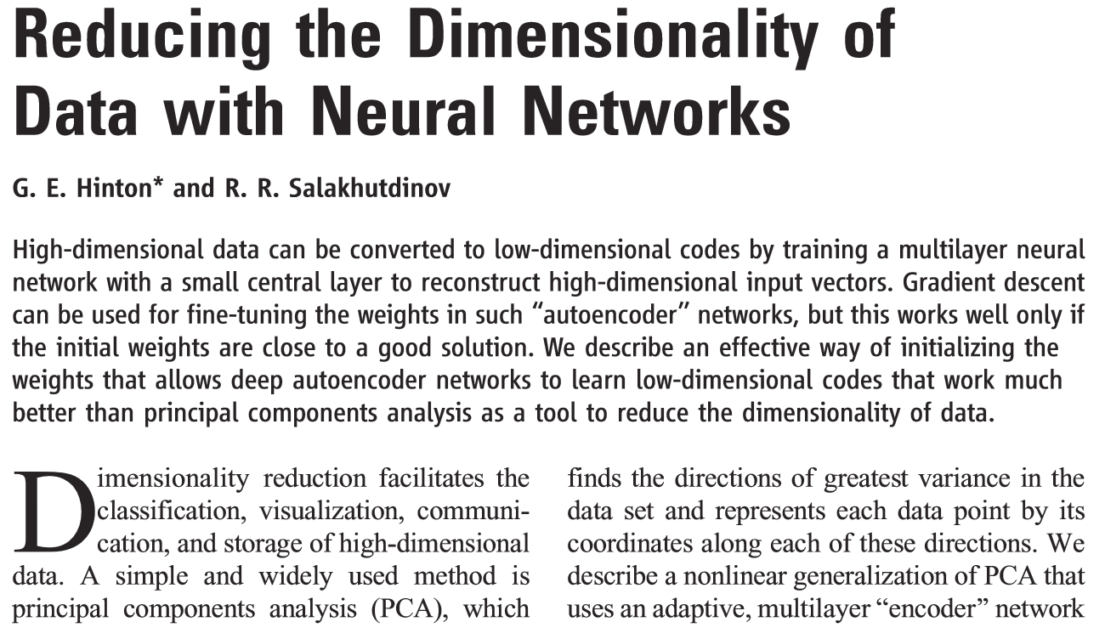
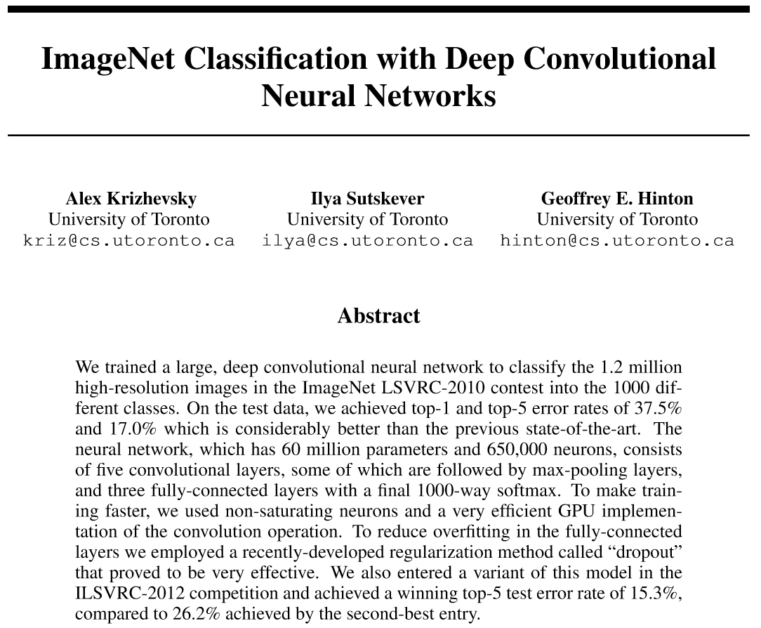
Deep learning in the past decade
Reducing the dimensionality of data with neural networks, Science, 2006
Fast learning algorithms for Restricted Boltzmann machine
ImageNet Classification with deep convolutional neural networks, NIPS, 2012
Dramatic performance improvement
ImageNet, GPU

Slide 3
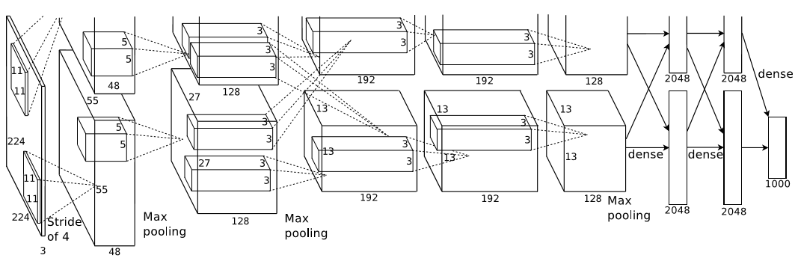
Deep convolutional neural networks
8 layers
AlexNet, 2012

Slide 4
Two architecture design paths
Going deeper
Stack multiple blocks: VGG
Improve information flow by skip connections
GoogleNet, Highway, ResNet, Deeply-Fused Nets, FractalNets, DenseNets, Merge-and-run

Slide 5
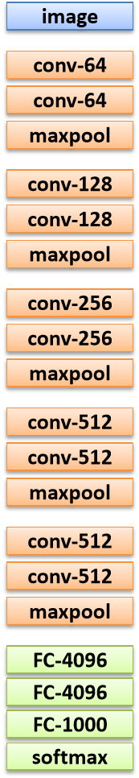
Stack multiple blocks
19 layers
VGGNet, 2014

Slide 6

Improve information flow
22 layers
GoogLeNet, 2014

Slide 7
Improve information flow
100+ layers
Highway, 2015

Slide 8
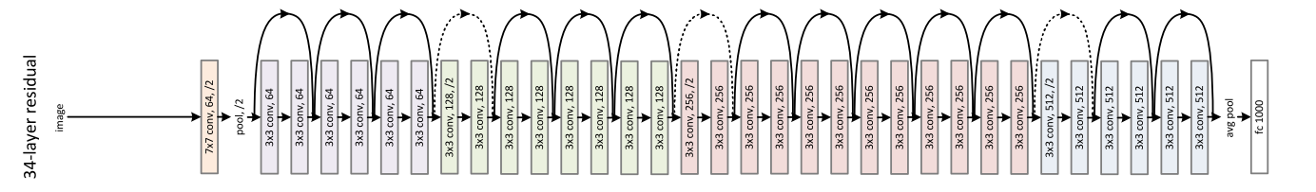
Improve information flow
152 layers
ResNet, 2015

Slide 9
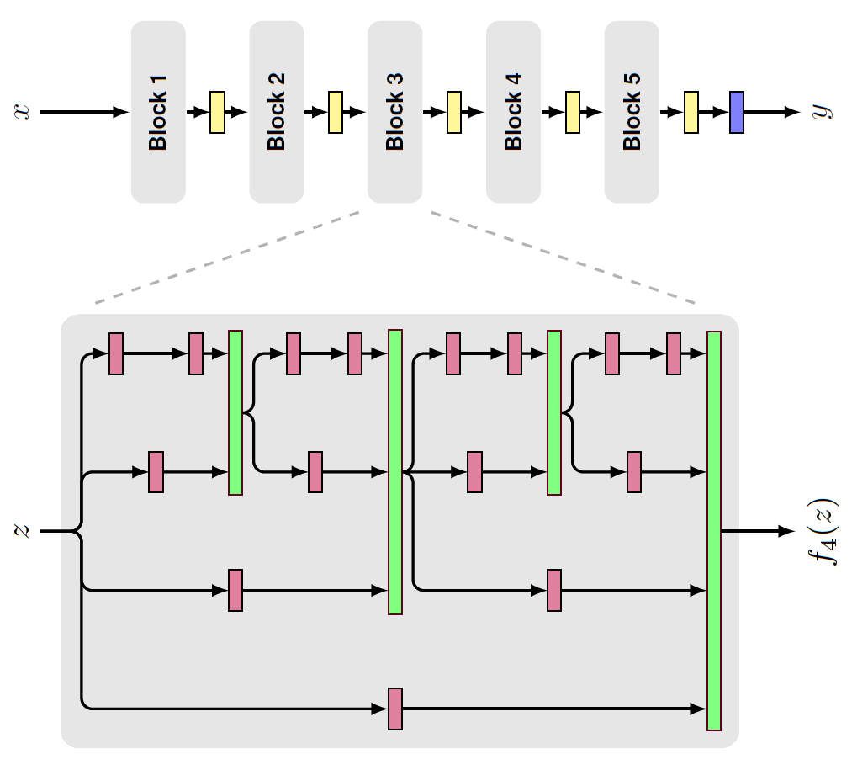
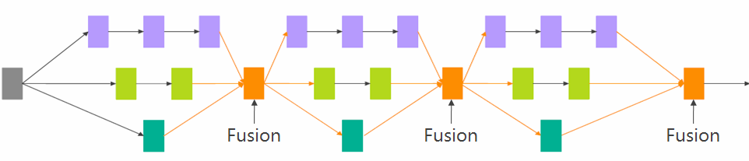
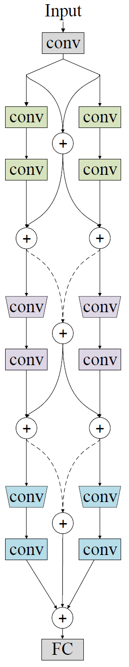
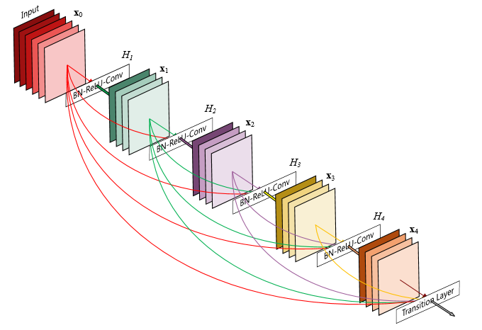
Improve information flow
Deeply-fused nets, 2016
FractalNets, 2016
DenseNets, 2016
Merge-and-Run Networks (DMRNets), 2016

Slide 10
Deeply-Fused Nets
Unifying GoogLeNets, Highway, ResNets
Jingdong Wang, Zhen Wei, Ting Zhang, Wenjun Zeng: Deeply-Fused Nets. CoRR abs/1605.07716 (2016)

Slide 11
A deeply-fused net can be formed from many different base networks

Slide 12
A deeply-fused net can be formed from many different base networks
Input
Input
C
C
C
L01
R01
L01
R01
R02
R02
+
=
+
L02
R03
L02
R03
R04
R04
+
+
L03
R05
L03
R05
R06
R06
+
+
FC
FC
FC
LLL
RRR

Slide 13
A deeply-fused net can be formed from many different base networks
Input
Input
C
C
C
L01
R01
L01
R01
R02
R02
+
=
+
L02
R03
R03
L02
R04
R04
+
+
L03
R05
R05
L03
R06
R06
+
+
FC
FC
FC
LRR
RLL

Slide 14
A deeply-fused net can be formed from many different base networks
Input
Input
C
C
C
L01
R01
L01
R01
R02
R02
+
=
+
L02
R03
R03
L02
R04
R04
+
+
L03
R05
L03
R05
R06
R06
+
+
FC
FC
FC
LRL
RLR

Slide 15
A deeply-fused net can be formed from many different base networks
Input
Input
C
C
C
L01
R01
L01
R01
R02
R02
+
=
+
L02
R03
L02
R03
R04
R04
+
+
L03
R05
R05
L03
R06
R06
+
+
FC
FC
FC
LLR
RRL

Slide 16
A deeply-fused net can be formed from many different base networks
Input
Input
C
C
C
C
C
C
C
C
C
L01
R01
L01
R01
L01
R01
L01
R01
L01
R01
R02
R02
R02
R02
R02
+
=
+
+
+
+
L02
R03
L02
R03
R03
L02
R03
L02
L02
R03
R04
R04
R04
R04
R04
+
+
+
+
+
L03
R05
L03
R05
R05
L03
L03
R05
R05
L03
R06
R06
R06
R06
R06
+
+
+
+
+
FC
FC
FC
FC
FC
FC
FC
FC
FC
LLL
RRR
LRR
RLL
LRL
RLR
LLR
RRL

Slide 17
A deeply-fused net is a multi-path multi-scale network

Slide 18
A deeply-fused net is a multi-path multi-scale network
Input
Input
C
C
C
C
C
C
C
C
C
L01
R01
L01
R01
L01
R01
L01
R01
L01
R01
R02
R02
R02
R02
R02
+
=
+
+
+
+
L02
R03
L02
R03
R03
L02
R03
L02
L02
R03
R04
R04
R04
R04
R04
+
+
+
+
+
L03
R05
L03
R05
R05
L03
L03
R05
R05
L03
R06
R06
R06
R06
R06
+
+
+
+
+
FC
FC
FC
FC
FC
FC
FC
FC
FC
LLL
RRR
LRR
RLL
LRL
RLR
LLR
RRL

Slide 19
A deeply-fused net is a multi-path multi-scale network
Input
Input
C
C
C
C
C
C
C
C
C
L01
R01
L01
R01
L01
R01
L01
R01
L01
R01
R02
R02
R02
R02
R02
+
L02
R03
L02
R03
R03
L02
R03
L02
L02
R03
R04
R04
R04
R04
R04
+
L03
R05
L03
R05
R05
L03
L03
R05
R05
L03
R06
R06
R06
R06
R06
+
FC
FC
FC
FC
FC
FC
FC
FC
FC
LLL
RRR
LRR
RLL
LRL
RLR
LLR
RRL

Slide 20
Each layer has an express way to input and output

Slide 21
Each layer has an express way to input and output
Input
Input
C
C
C
C
C
C
C
C
C
L01
R01
L01
R01
L01
R01
L01
R01
L01
R01
R02
R02
R02
R02
R02
+
L02
R03
L02
R03
R03
L02
R03
L02
L02
R03
R04
R04
R04
R04
R04
+
L03
R05
L03
R05
R05
L03
L03
R05
R05
L03
R06
R06
R06
R06
R06
+
FC
FC
FC
FC
FC
FC
FC
FC
FC
LLL
RRR
LRR
RLL
LRL
RLR
LLR
RRL

Slide 22
Each layer has an express way to input and output
Input
Input
C
C
C
C
C
L01
R01
L01
R01
L01
R01
R02
R02
R02
3 layers
2 layers
+
L02
R03
L02
R03
R03
L02
R04
R04
R04
+
4 layers
3 layers
L03
R05
L03
R05
L03
R05
R06
R06
R06
+
FC
FC
FC
FC
FC
LLL
RRR
LRL
RLR

Slide 23
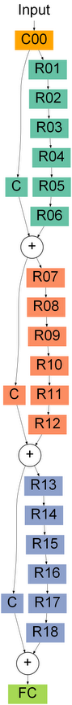
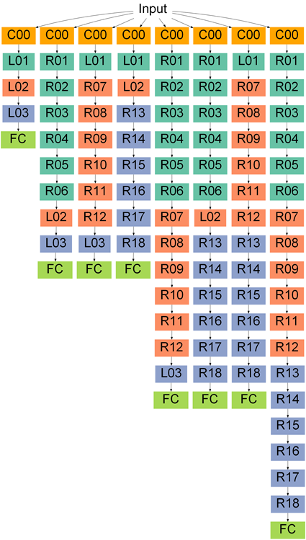


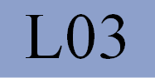
2
7
7
12

Slide 24
Unifying GoogLeNets, Highway, ResNets
Deep fusion
Multiple paths
Long and short
Weight sharing
Express way between layers

Slide 25
Another dimension:
Go wider
Deeper and deeper
Wider
Notes:
In this work, we consider another direction to increase the capacity

Slide 26
Going wider
by assembling convolutional branches in parallel
with merge-and-run mappings:
reduce the training difficulty and increase the capacity
Liming Zhao, Mingjie Li, Depu Meng, Xi Li, Zhaoxiang Zhang, Yueting Zhuang, Zhuowen Tu, Jingdong Wang: Deep Convolutional Neural Networks with Merge-and-Run Mappings. IJCAI 2018: 3170-3176
Liming Zhao, Jingdong Wang, Xi Li, Zhuowen Tu: On the Connection of Deep Fusion to Ensembling. CoRR abs/1611.07718 (2016)
Notes:
Let me introduce a simple way for going less deep wider:
Assembling branches in parallel with merge and run mappings.

Slide 27
Residual connection
Identity connection
Notes:
Here is an example ResNet, there are 6 blocks: in each block on identify connection, and residual

Slide 28
Assemble residual branches: from sequential to parallel
Merge-and-run
Vanilla
Merge-and-run
Sequential
Parallel
Notes:
Our idea is very simple: just assemble residual branches from sequential to parallel:
This figure are two residual blocks, which are sequentially stacked.
We provide two ways to assemble the residual branches in parallel:
The first one is vanilla assembly: sum up the two residual branches and the identity mappings.
The second is the merge-and-run block: it assembles the two branches in parallel and uses
The merge-and-run to do the communication of the two branches.

Slide 29
Residual connection
Identity connection
ResNets
DVANets
DMRNets
Notes:
Here are the three networks: renets, deep vanilla assembly networks, and deep merge-and
Run networks.

Slide 30
(1) Wider: ResNet < DVANet < DMRNet
<
<
Notes:
Let’s see the benefits:
The first one is wider

Slide 31
(2) Less deep: ResNet > DVANet > DMRNet
>
>
Notes:
The second one is less deep

Slide 32
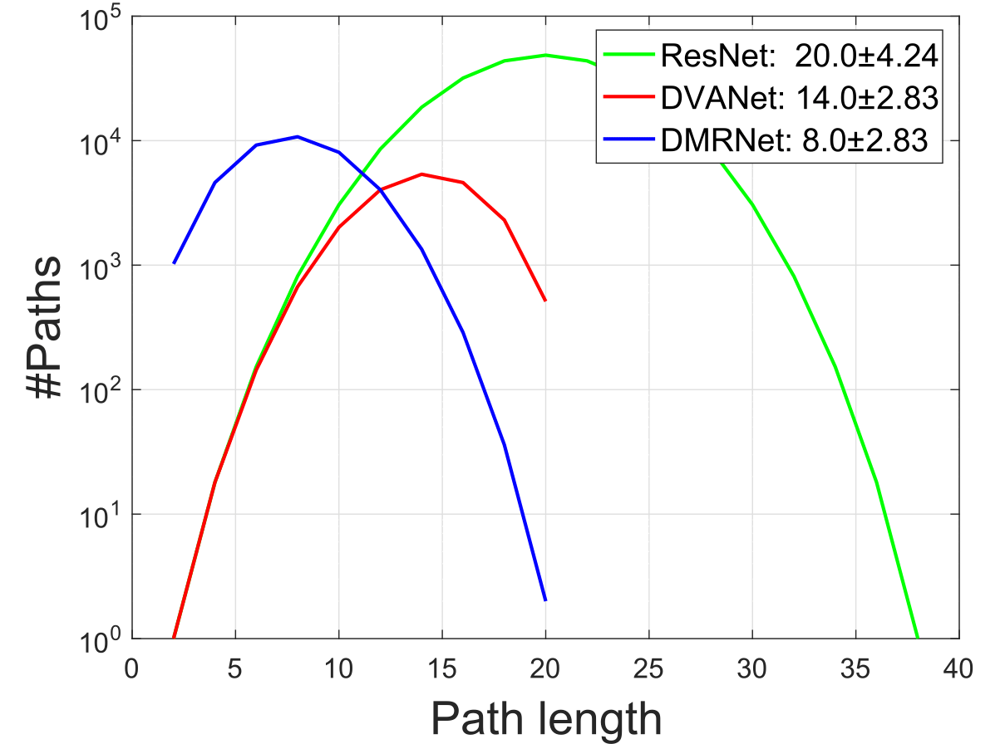
(2) Less deep: ResNet > DVANet > DMRNet
Notes:
Here is the distributions of the path lengths of the three networks.
We can see that overall, DMRNet is the least deep
L=9,
ResNet= 18 blocks + first conv, + FC
D

Slide 33
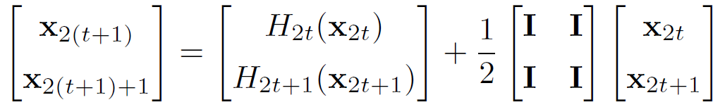
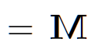
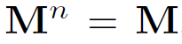
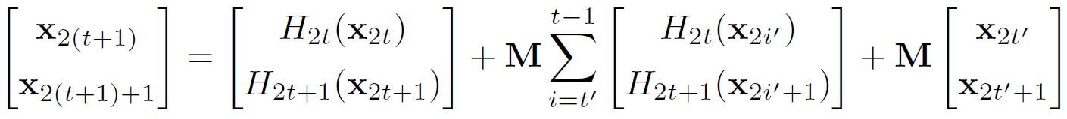
(3) Merge-and-run mappings improve information flow
Merge-and-run
is idempotent:
Quick path from t’ to t
Notes:
Third, we introduce merge-and-run mappings can improve information flow.
(1) The block is mathematically written in this form, and the merge-and-run mappings correspond to this matrix, four-block matrix, and each block is an identity matrix. It is denoted by M.
(2) This matrix has an interesting property: M multipled with itself leads itself, and even its power n is equal to M
10的7次方:the seventh power of ten或ten to the seventh power.
Such a matrix is called idempotent matrix.
(3) This equation is about transforming the output of t’ block to the (t+1) block.
We can see that x of t’ is transformed to x of t+1 only through one M,
X of t’, multiplied by M, is directly sent to x of (t+1)
though there are more than 1 merge and run mappings.
In other words, there is a quick from t’ to t, through merge-and-run mappings.
Because the merge-and-run mapping is idempotent,

Slide 34
Experimental results - datasets
 | #(training images) | #(testing images) | #classes
CIFAR-10 | 50,000 | 10,000 | 10
CIFAR-100 | 50,000 | 10,000 | 100
SVHN | 73,257 + 531,131 | 26,032 | 10
ImageNet | 1.2M+ | 50,000 | 1000
Notes:
Now let’s look at some results on three standard datasets.
CIFAR-10
SVHN
The Canadian Institute for Advanced Research
The CIFAR-10 and CIFAR-100 are labeled subsets of the 80 million tiny images dataset

Slide 35
Comparison with baseline networks
#parameters | Depth | ResNets | W-ResNets | DVANets | DMRNets
0.4M | 26 | 6.62 ± 0.24 | 6.62 ± 0.20 | 6.53 ± 0.12 | 6.48 ± 0.04
0.6M | 38 | 5.93 ± 0.17 | 6.12 ± 0.13 | 5.83 ± 0.09 | 5.79 ± 0.13
1.2M | 74 | 5.35 ± 0.14 | 5.47 ± 0.18 | 5.26 ± 0.20 | 5.18 ± 0.20
1.5M | 98 | 5.26 ± 0.09 | 5.55 ± 0.13 | 5.05 ± 0.20 | 4.99 ± 0.13
CIFAR-10 classification error, average over 5 runs
Notes:
More detailed compareson with ResNets, different depth.
The max depth of our approach

Slide 36
Comparison with baseline networks
Simply increase #channels
with the depth = depth of DMRNets
#parameters | Depth | ResNets | W-ResNets | DVANets | DMRNets
0.4M | 26 | 6.62 ± 0.24 | 6.62 ± 0.20 | 6.53 ± 0.12 | 6.48 ± 0.04
0.6M | 38 | 5.93 ± 0.17 | 6.12 ± 0.13 | 5.83 ± 0.09 | 5.79 ± 0.13
1.2M | 74 | 5.35 ± 0.14 | 5.47 ± 0.18 | 5.26 ± 0.20 | 5.18 ± 0.20
1.5M | 98 | 5.26 ± 0.09 | 5.55 ± 0.13 | 5.05 ± 0.20 | 4.99 ± 0.13
CIFAR-10 classification error, average over 5 runs
Notes:
More detailed comparison with ResNets, different depth. From 12 to 96

Slide 37
Comparison with baseline networks
Less wide than DMRNets
Identity mapping other merge-and-run
#parameters | Depth | ResNets | W-ResNets | DVANets | DMRNets
0.4M | 26 | 6.62 ± 0.24 | 6.62 ± 0.20 | 6.53 ± 0.12 | 6.48 ± 0.04
0.6M | 38 | 5.93 ± 0.17 | 6.12 ± 0.13 | 5.83 ± 0.09 | 5.79 ± 0.13
1.2M | 74 | 5.35 ± 0.14 | 5.47 ± 0.18 | 5.26 ± 0.20 | 5.18 ± 0.20
1.5M | 98 | 5.26 ± 0.09 | 5.55 ± 0.13 | 5.05 ± 0.20 | 4.99 ± 0.13
CIFAR-10 classification error, average over 5 runs
Notes:
More detailed comparison with ResNets, different depth. From 12 to 96

Slide 38
Comparison with baseline networks
#parameters | Depth | ResNets | W-ResNets | DVANets | DMRNets
0.4M | 26 | 6.62 ± 0.24 | 6.62 ± 0.20 | 6.53 ± 0.12 | 6.48 ± 0.04
0.6M | 38 | 5.93 ± 0.17 | 6.12 ± 0.13 | 5.83 ± 0.09 | 5.79 ± 0.13
1.2M | 74 | 5.35 ± 0.14 | 5.47 ± 0.18 | 5.26 ± 0.20 | 5.18 ± 0.20
1.5M | 98 | 5.26 ± 0.09 | 5.55 ± 0.13 | 5.05 ± 0.20 | 4.99 ± 0.13
CIFAR-10 classification error, average over 5 runs
Notes:
More detailed comparison with ResNets, different depth. From 12 to 96

Slide 39
Comparison with baseline networks
#parameters | Depth | ResNets | W-ResNets | DVANets | DMRNets
0.4M | 26 | 29.69 ± 0.15 | 29.59 ± 0.31 | 29.75 ± 0.27 | 29.62 ± 0.08
0.6M | 38 | 27.90 ± 0.26 | 27.95 ± 0.26 | 27.87 ± 0.22 | 27.80 ± 0.26
1.2M | 74 | 26.00 ± 0.48 | 25.99 ± 0.28 | 25.98 ± 0.23 | 25.41 ± 0.19
1.5M | 98 | 25.44 ± 0.20 | 25.38 ± 0.37 | 24.76 ± 0.33 | 24.73 ± 0.40
CIFAR-100 classification error, average over 5 runs
Notes:
More detailed compareson with ResNets, different depth.
The max depth of our approach

Slide 40
Comparison with baseline networks
#parameters | Depth | ResNets | W-ResNets | DVANets | DMRNets
0.4M | 26 | 1.90 ± 0.08 | 2.25 ± 0.03 | 2.13 ± 0.09 | 2.00 ± 0.04
0.6M | 38 | 1.97 ± 0.09 | 2.10 ± 0.06 | 1.96 ± 0.10 | 1.87 ± 0.09
1.2M | 74 | 1.90 ± 0.04 | 2.05 ± 0.02 | 1.81 ± 0.11 | 1.77 ± 0.11
1.5M | 98 | 1.91 ± 0.03 | 2.08 ± 0.06 | 1.84 ± 0.06 | 1.84 ± 0.15
SVHN classification error, average over 5 runs
Notes:
More detailed compareson with ResNets, different depth.
The max depth of our approach

Slide 41
ImageNet classification
 | ResNet-98 | DMRNet-50
 | 45M | 46.4M
Top-1 validation error | 23.38 | 23.16
Top-5 validation error | 6.79 | 6.64
Top-1 training error | 15.09 | 14.46
Top-5 training error | 3.25 | 3.16
Notes:
Here let’s see a comparison on ImageNet 101,
Convergence curve:
Red curves correspond to resnet, blue curves correspond to our approach.
Dashed line is training error, and solid line is validation error.
We can see that the blue curves are under the red curves, including both dashed- and solid lines. This means both training and validation accuracy are higher.
The table shows the comparison for the final converged model.
One point I would like to highlight is that
Our approach does not aim to eliminate the overfitting degree because training error is also small, but aim to increase the capability.
Our depth is 44.

Slide 42
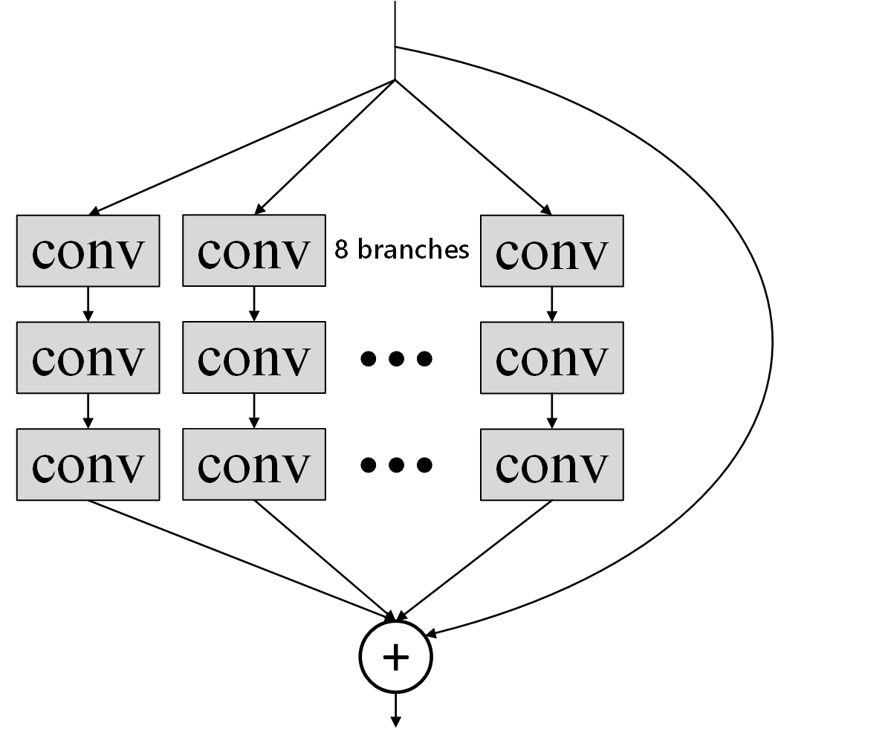
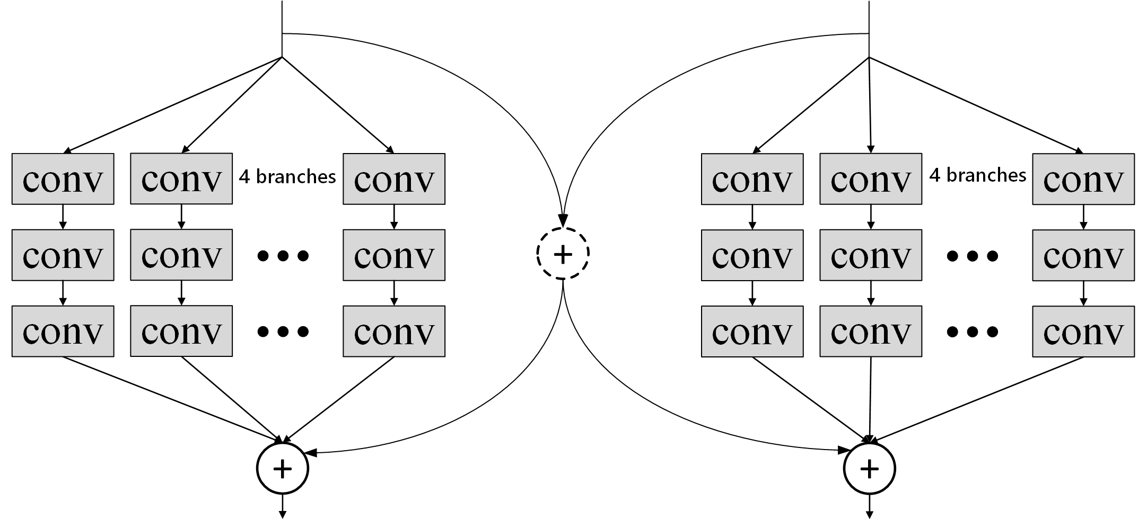
Comparison to ResNeXt
depth | CIFAR-10 |  | CIFAR-100
 | ResNeXt | DMRNeXt | ResNeXt | DMRNeXt
20 | 6.79 ± 0.38 | 6.70 ± 0.19 | 26.64 ± 0.48 | 26.61 ± 0.19
29 | 5.77 ± 0.22 | 5.62 ± 0.21 | 25.45 ± 0.18 | 25.12 ± 0.23
38 | 5.61 ± 0.19 | 5.45 ± 0.19 | 25.01 ± 0.36 | 24.52 ± 0.42
wider
ResNext
DMRNeXt

Slide 43
Comparison to Xception
depth | CIFAR-10 |  | CIFAR-100
 | Xception | DMRNets | Xception | DMRNets
14 | 8.16 ± 0.54 | 8.00 ± 0.18 | 30.84 ± 0.44 | 30.40 ± 0.09
20 | 7.87 ± 0.14 | 7.83 ± 0.20 | 30.58 ± 0.98 | 29.71 ± 0.20
38 | 7.85 ± 0.60 | 7.77 ± 0.08 | 30.39 ± 0.94 | 29.52 ± 0.31
wider
Xception
DMRNet

Slide 44
Comparison with state-of-the-arts
Method | Depth | #Params. | CIFAR-10 | CIFAR-100 | SVHN
FractalNet with DO/DP | 21 | 38.6M | 5.22 | 23.30 | 2.01
 | 21 | 38.6M | 4.60 | 23.73 | 1.87
ResNet | 110 | 1.7M | 6.41 | 27.22 | 2.01
ResNet (pre-act) | 164 | 1.7M | 5.46 | 24.33 | -
Wide ResNet | 16 | 11.0M | 4.81 | 22.07 | -
 | 28 | 36.5M | 4.17 | 20.50 | -
DenseNet | 100 | 27.2M | 3.74 | 19.25 | 1.59
DenseNet-BC | 250 | 15.3M | 3.62 | 17.6 | 1.74
DenseNet-BC | 190 | 25.6M | 3.46 | 17.18 | -
ResNeXt | 29 | 34.4M | 3.65 | 17.77 | -
PyramidNet | 272 | 26.0M | 3.31 | 16.35 | -
IGC-L450M2 | 20 | 19.3M | 3.25 | 19.25 | -
IGC-L32M26 | 20 | 24.1M | 3.31 | 18.75 | 1.56
DMRNet (ours) | 56 | 1.7M | 4.94 | 24.46 | 1.66
DMRNet-Wide (ours) | 32 | 14.9M | 3.94 | 19.25 | 1.51
DMRNet-Wide (ours) | 50 | 24.8M | 3.57 | 19.00 | 1.55
DMRNeXt (ours) | 29 | 26.7M | 3.06 | 17.55 | -
Red:1st
Green: 2nd
Blue: 3rd
Notes:
Here is the result. We mainly compare to resnets, and its variants.
For fairness, we donot compare to bottleneck networks. We can see that our approach gets better results.

Slide 45
Merge-and-run mappings vs. Identity mappings
L | CIFAR-10 |  | CIFAR-100
 | Identity | Merge-and-run | Identity | Merge-and-run
48 | 5.21 | 4.99 | 25.31 | 24.73
96 | 5.19 | 4.84 | 24.16 | 23.98
Identity
Merge-and-run
Notes:
Finally, I would like to show the comparison to a straightforward baseline for assembling residual branches in parallel.
Just replace merge-and-run mappings with two identity connections.
The comparison is given in this table, and we can see that merge-and-run is better. This shows that the interaction between two branches introduced in merge-and-run is really helpful for improving the performance.

Slide 46
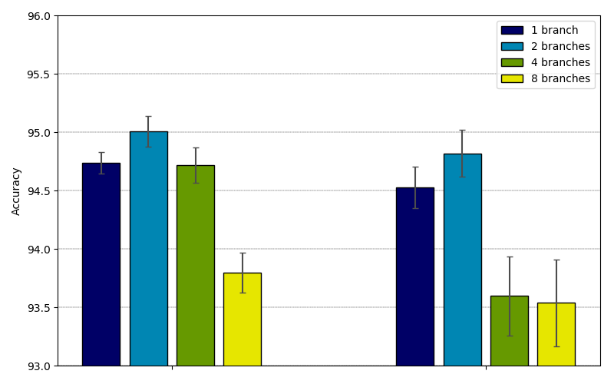
The effect of #branches
Same depth
Same width sum
CIFAR 10
Notes:
CIFAR 10

Slide 47
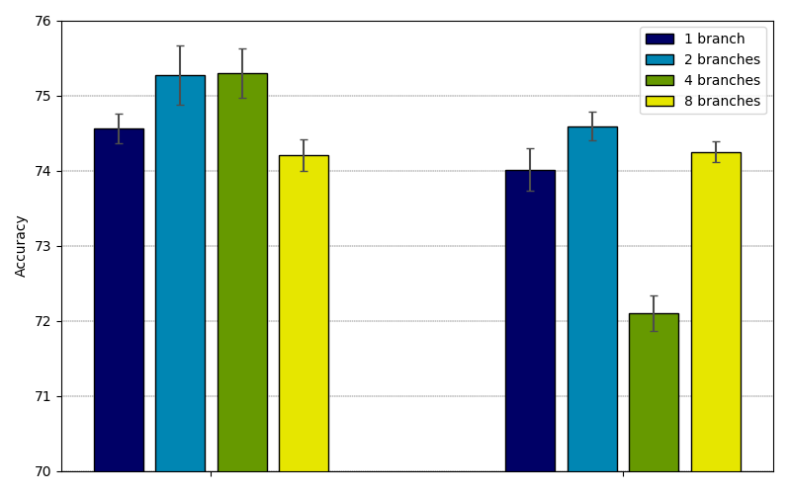
The effect of #branches
Same depth
Same width sum
CIFAR 10
Notes:
CIFAR 100

Slide 48
Summary & conclusion
Merge-and-run mappings
Improve information flow like identity mappings
Assemble convolutions in parallel
Multi-branch structures
Group convolutions
Parameter-efficient
Two design rules:
Very deep, but not extremely deep
Wide

Slide 49
Two architecture design paths
Going deeper
Stack multiple blocks: VGG
Improve information flow by skip connections
GoogleNet, Highway, ResNet, Deeply-Fused Nets, FractalNets, DenseNets, Merge-and-run
Eliminate the redundancy
Convolution operations

Slide 50
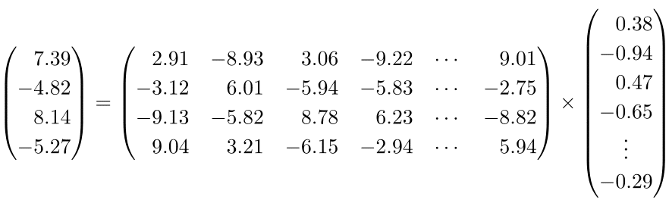
Convolution

Slide 51
Convolution

Slide 52
Convolution

Slide 53
Convolution

Slide 54
Two architecture design paths
Going deeper
Stack multiple blocks: VGG
Improve information flow by skip connections
GoogleNet, Highway, ResNet, Deeply-Fused Nets, FractalNets, DenseNets, Merge-and-run
Eliminate the redundancy
Convolution operations
Low-precision kernels

Slide 55
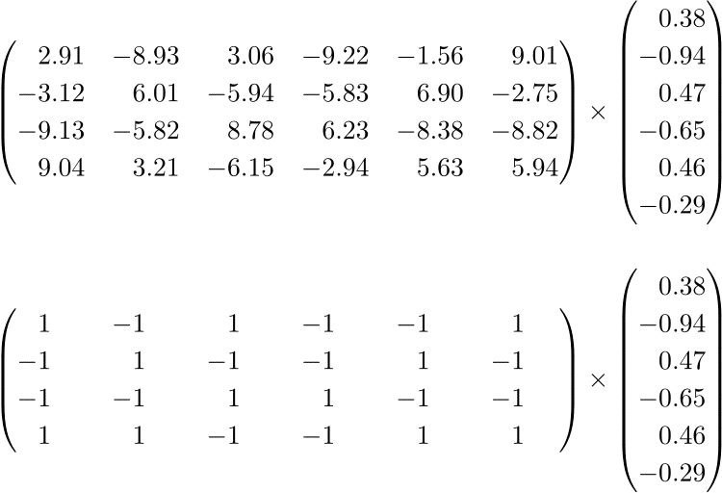
Low-precision kernels
Binarization
Integer
Quantization

Slide 56
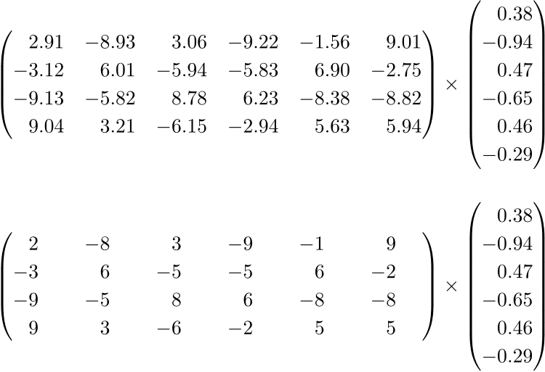
Low-precision kernels
Binarization
Integer
Quantization

Slide 57
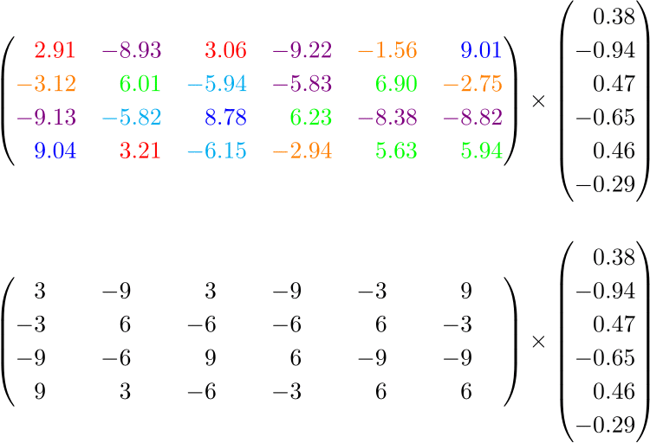
Low-precision kernels
Binarization
Integer
Quantization

Slide 58
Two architecture design paths
Going deeper
Stack multiple blocks: VGG
Improve information flow by skip connections
GoogleNet, Highway, ResNet, Deeply-Fused Nets, FractalNets, DenseNets, Merge-and-run
Eliminate the redundancy
Convolution operations
Low-precision kernels
Low-rank kernels

Slide 59
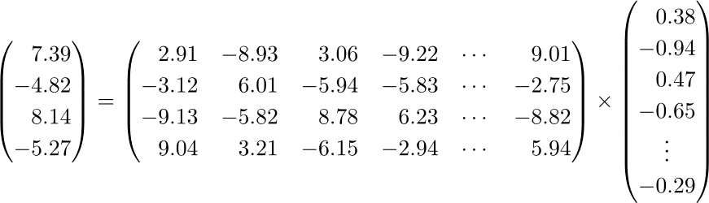
Low-rank kernels
Filter pruning
Channel pruning

Slide 60
Low-rank kernels
Filter pruning
Channel pruning

Slide 61
Low-rank kernels
Filter pruning
Channel pruning

Slide 62
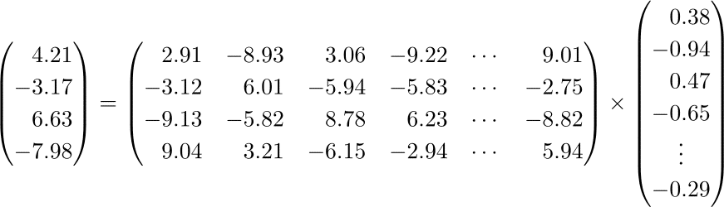
Low-rank kernels
Filter pruning
Channel pruning

Slide 63
Two architecture design paths
Going deeper
Stack multiple blocks: VGG
Improve information flow by skip connections
GoogleNet, Highway, ResNet, Deeply-Fused Nets, FractalNets, DenseNets, Merge-and-run
Eliminate the redundancy
Convolution operations
Low-precision kernels
Low-rank kernels
Composition from low-rank kernels

Slide 64
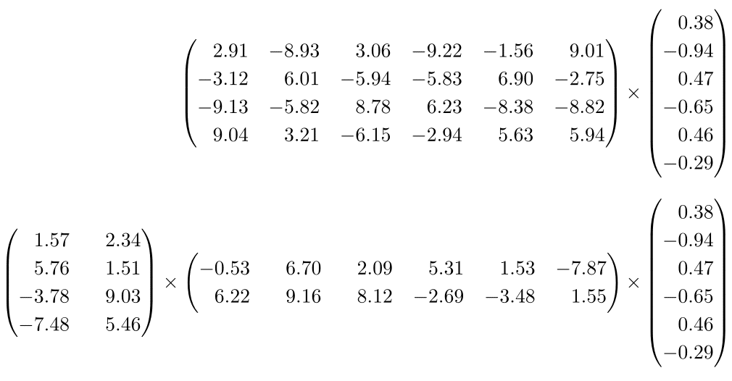
Composition from low-rank kernels

Slide 65
Two architecture design paths
Going deeper
Stack multiple blocks: VGG
Improve information flow by skip connections
GoogleNet, Highway, ResNet, Deeply-Fused Nets, FractalNets, DenseNets, Merge-and-run
Eliminate the redundancy
Convolution operations
Low-precision kernels
Low-rank kernels
Composition from low-rank kernels
Sparse kernels

Slide 66
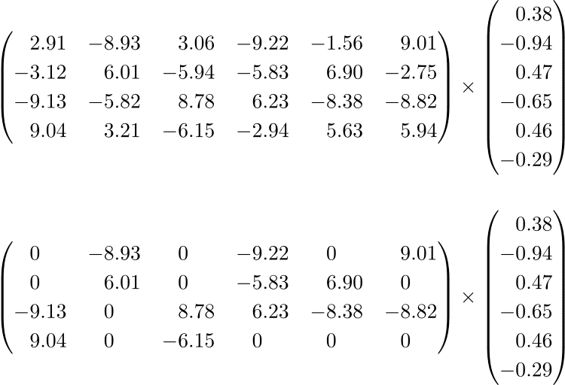
Sparse kernels
Non-structured sparse
Structured sparse

Slide 67
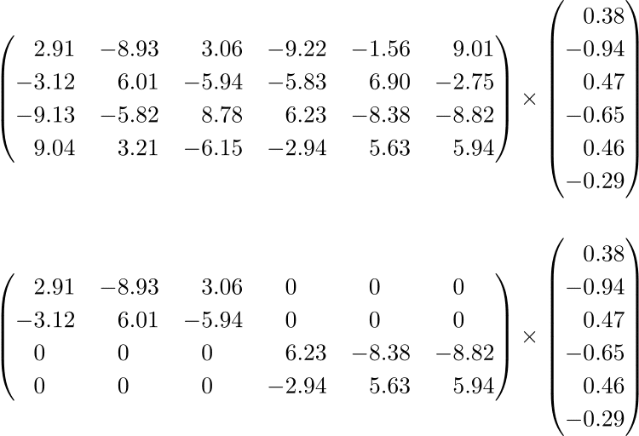
Sparse kernels
Non-structured sparse
Structured sparse

Slide 68
Two architecture design paths
Going deeper
Stack multiple blocks: VGG
Improve information flow by skip connections
GoogleNet, Highway, ResNet, Deeply-Fused Nets, FractalNets, DenseNets, Merge-and-run
Eliminate the redundancy
Convolution operations
Low-precision kernels
Low-rank kernels
Composition from low-rank kernels
Sparse kernels
Composition from sparse kernels

Slide 69
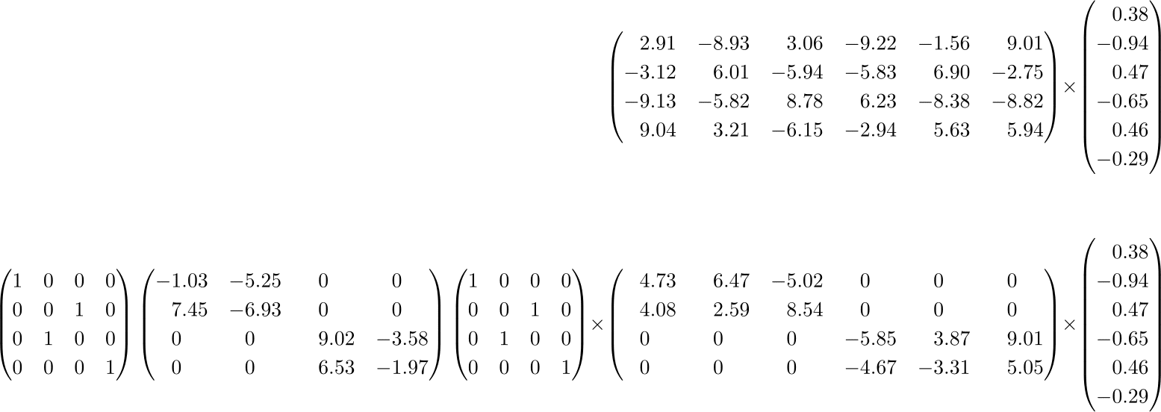
Composition from sparse kernels
Interleaved group convolutions
[1] Ting Zhang, Guo-Jun Qi, Bin Xiao, Jingdong Wang: Interleaved Group Convolutions. ICCV 2017: 4383-4392
[2] Guotian Xie, Jingdong Wang, Ting Zhang, Jianhuang Lai, Richang Hong, and Guo-JunQi. IGCV2: Interleaved Structured Sparse Convolutional Neural Networks. CVPR 2018.
[3] Ke Sun, Mingjie Li, Dong Liu, and Jingdong Wang. IGCV3: Interleaved Low-Rank Group Convolutions for Efficient Deep Neural Networks. BMVC 2018.

Slide 70
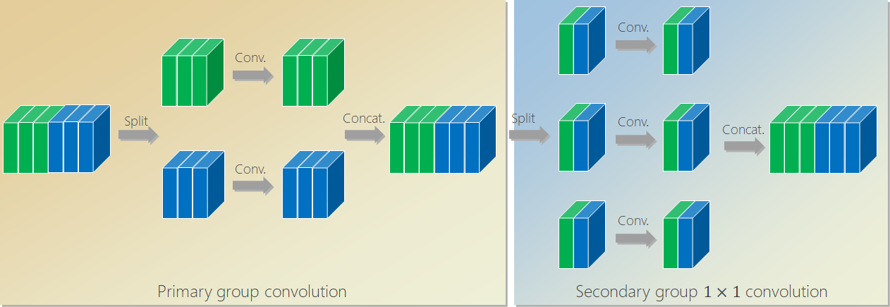
IGCV1: Interleaved group convolutions for large models
Ting Zhang, Guo-Jun Qi, Bin Xiao, Jingdong Wang: Interleaved Group Convolutions, ICCV 2017.
Blog: https://mp.weixin.qq.com/s/PiQB2AvhtDceMJxYN8O8jA

Slide 71
Regular convolution
Complexity: $6×5×5×6$
Conv
Channel
Notes:
Here is a regular convolution.
Input includes 6 maps or channels. The output contains 6 channels.

Slide 72
Group convolution
Conv.
Complexity: $2×(3×5×5×3)$
Split
Concat.
Conv.
Conduct convolutions separately over the partitions
Computation cost is lower than regular convolutions

Slide 73
Interleaved group convolution (IGC)
Conv.
Conv.
Split
Concat.
Split
Conv.
Concat.
Conv.
Conv.
Each output channel is connected to each input channel fed into the block
Primary group convolution
Secondary group $1×1$convolution
L=2 primary partitions
3 channels in each partition
M=3 secondary partitions
2 channels in each partition

Slide 74
Conv.
Conv.
Split
Concat.
Split
Conv.
Concat.
Conv.
Conv.
The path connecting each input channel with each output channel

Slide 75

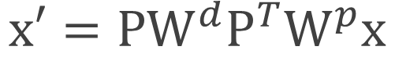
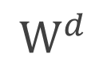
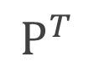
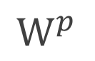

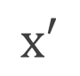
Matrix form
Conv.
Conv.
Split
Concat.
Split
Conv.
Concat.
Conv.
$$P$$
$$x$$
$$P^{T}$$
$$x′$$
Conv.
$$W^{p}$$
$$W^{d}$$
$$x′=PW^{d}P^{T}W^{p}x$$

Slide 76

Criterion: Strict complementary condition
Strict complementary condition:
The channels lying in the same branch in one group convolution lie in different branches and come from all the branches in the other group convolution.
We have: the resulting convolution kernel matrix is dense
$$x′=PW^{d}P^{T}W^{p}x$$

Slide 77
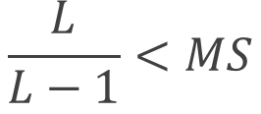
Advantages: Wider than regular convolutions
Condition:
$$\frac{L}{L−1}<MS$$
#(Primary partitions)
#(Secondary partitions)
Spatial kernel size
Thus, our IGC is wider except $L=1$ under the same #parameters
Notes:
Here is the condition when our block is wider than regular convolutions.
under the same number of parameters, and same computation complexity.
Here, L, M S are all positive integers, and S is kernel size, and larger than 1. It can be easily verified that this inequality always holds except L=1, which is an extreme case.

Slide 78
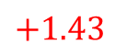
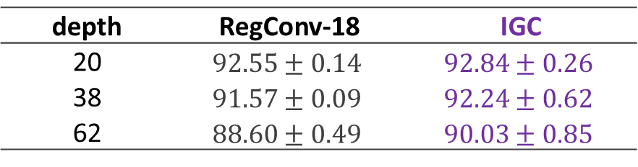
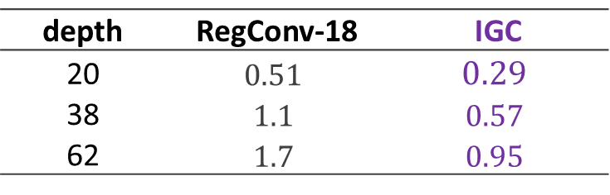
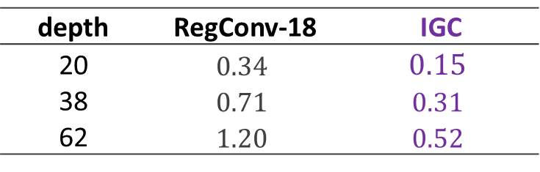
Comparison to regular convolutions
CIFAR-10 classification accuracy
depth | RegConv-18 | IGC
20 | $$92.55±0.14$$ | $$92.84±0.26$$
38 | $$91.57±0.09$$ | $$92.24±0.62$$
62 | $$88.60±0.49$$ | $$90.03±0.85$$
$$+1.43$$
Model size: #params ($×{10}^{6}$)
Computation complexity: FLOPS ($×{10}^{8}$)
depth | RegConv-18 | IGC
20 | $$0.34$$ | $$0.15$$
38 | $$0.71$$ | $$0.31$$
62 | $$1.20$$ | $$0.52$$
depth | RegConv-18 | IGC
20 | $$0.51$$ | $$0.29$$
38 | $$1.1$$ | $$0.57$$
62 | $$1.7$$ | $$0.95$$
Notes:
24 * 2
Three stage.

Slide 79
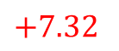
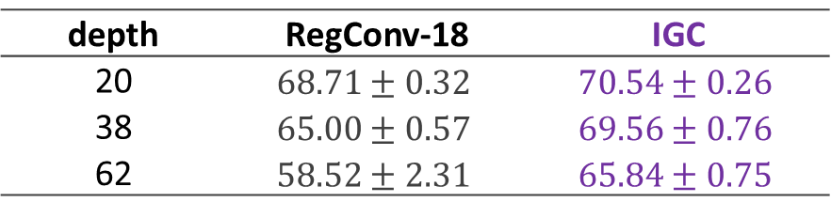
Comparison to regular convolutions
CIFAR-100 classification accuracy
depth | RegConv-18 | IGC
20 | $$68.71±0.32$$ | $$70.54±0.26$$
38 | $$65.00±0.57$$ | $$69.56±0.76$$
62 | $$58.52±2.31$$ | $$65.84±0.75$$
$$+7.32$$
Model size: #params ($×{10}^{6}$)
Computation complexity: FLOPS ($×{10}^{8}$)
depth | RegConv-18 | IGC
20 | $$0.34$$ | $$0.15$$
38 | $$0.71$$ | $$0.31$$
62 | $$1.20$$ | $$0.52$$
depth | RegConv-18 | IGC
20 | $$0.51$$ | $$0.29$$
38 | $$1.1$$ | $$0.57$$
62 | $$1.7$$ | $$0.95$$
Notes:
24 * 2

Slide 80
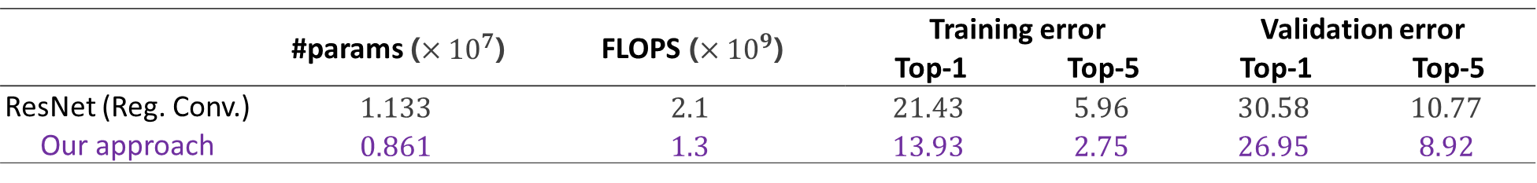
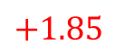
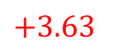
Comparison to ResNets on ImageNet classification
 | #params ($×{10}^{7}$) | FLOPS ($×{10}^{9}$) | Training error |  | Validation error
 |  |  | Top-1 | Top-5 | Top-1 | Top-5
ResNet (Reg. Conv.) | $$1.133$$ | $$2.1$$ | $$21.43$$ | $$5.96$$ | $$30.58$$ | $$10.77$$
Our approach | $$0.861$$ | $$1.3$$ | $$13.93$$ | $$2.75$$ | $$26.95$$ | $$8.92$$
$$+3.63$$
$$+1.85$$
Our approach: replace regular convolutions with our interleaved group convolutions
Notes:
Depth: 18,
64, 128, 256, 512
Single crop
Ours: 100 * 2
200 * 2
400*2
800 * 2

Slide 81
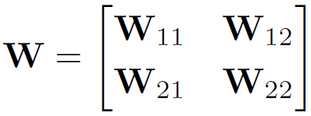
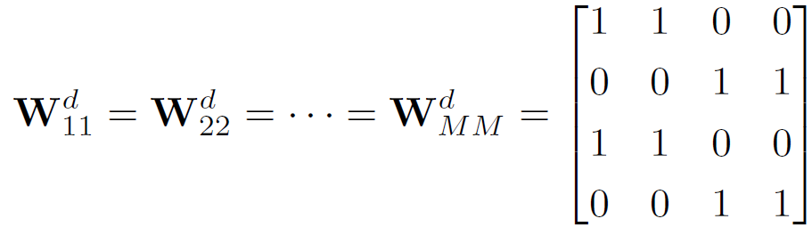
Regular convolutions are interleaved group convolutions
Four-branch representation
Primary group convolution
Secondary group convolution
Primary
Secondary

Slide 82
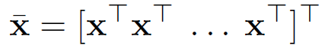


Regular convolutions are interleaved group convolutions
A channel-wise view
Primary group convolution
Secondary group convolution

Slide 83

Xception is a special case of IGC
c
Conv.
Conv.
Conv.
Split
Conv.
Concat.
Conv.
Conv.
Conv.
Conv.

Slide 84

Accuracy under same #params and FLOPS
Best accuracy
M=2: Higher accuracy than Xception
width
23 | 32 | 39 | 50 | 54 | 72 | 84 | 80 | 64
44 | 62 | 88 | 124 | 154 | 184 | 196 | 205 | 192 | 170 | 128
Xception

Slide 85



Comparison to Xception
CIFAR-100, Small network
 | Xception | Our approach
testing error | $$36.93±0.54$$ | $$36.11±0.62$$
#params | $$3.62×{10}^{4}$$ | $$3.80×{10}^{4}$$
FLOPS | $$3.05×{10}^{7}$$ | $$3.07×{10}^{7}$$
$$−0.82$$
CIFAR-100, Large network
 | Xception | Our approach
testing error | $$32.87±0.67$$ | $$31.87±0.58$$
#params | $$1.21×{10}^{5}$$ | $$1.26×{10}^{5}$$
FLOPS | $$1.11×{10}^{8}$$ | $1.12×{10}^{8}$
$$−1.00$$
Notes:
64, 1
40, 2
128, 1
85, 2

Slide 86
Deep roots: IGC’s variant
c
Conv.
c
Conv.
Conv.
c
c
Split
Concat
Conv.
Split
Concat
Conv.
Conv.
Conv.
Secondary group convolution
Point-wise convolution
Conv.
Primary group convolution
Primary group convolution

Slide 87

Comparison to deep roots
Our approach

Slide 88
Comparison with state-of-the-arts
Method | Depth | #Params. | CIFAR-10 | CIFAR-100 | SVHN
FractalNet with DO/DP | 21 | 38.6M | 5.22 | 23.30 | 2.01
 | 21 | 38.6M | 4.60 | 23.73 | 1.87
ResNet | 110 | 1.7M | 6.41 | 27.22 | 2.01
Multi ResNet | 200 | 10.2M | 4.35 | 20.42 | -
Wide ResNet | 16 | 11.0M | 4.81 | 22.07 | -
 | 28 | 36.5M | 4.17 | 20.50 | -
DenseNet | 40 | 1.0M | 5.24 | 24.42 | 1.79
 | 100 | 27.2M | 3.74 | 19.25 | 1.59
DMRNet | 56 | 1.7M | 4.94 | 24.46 | 1.66
DMRNet-Wide | 32 | 14.9M | 3.94 | 19.25 | 1.51
DMRNet-Wide | 50 | 24.8M | 3.57 | 19.00 | 1.55
IGC-L16M32 | 20 | 17.7M | 3.37 | 19.31 | 1.63
IGC-L450M2 | 20 | 19.3M | 3.30 | 19.00 | -
IGC-L32M26 | 20 | 24.1M | 3.31 | 18.75 | 1.56
Notes:
5000 training, 1000 testing
73; 257 training images, 26; 032 test

Slide 89

IGCV2: Interleaved Structured Sparse
Convolutional Neural Networks
Guotian Xie, Jingdong Wang, Ting Zhang, Jianhuang Lai, Richang Hong, and Guo-JunQi. IGCV2: Interleaved Structured Sparse Convolutional Neural Networks. CVPR 2018.

Slide 90
Interleaved group convolutions for small models
Structured sparse matrix composition
2 → Multiple structured sparse matrices
Benefit: further redundancy reduction (much sparser)
Guotian Xie, Jingdong Wang et. al. IGCV2: Interleaved Structured Sparse Convolutional Neural Networks. CVPR 2018.

Slide 91
IGCV1
c
c
Conv.
Conv.
Conv.
Split
Concat
Split
Concat
Conv.
Conv.
Conv.

Slide 92
Multiple structured sparse matrix composition
c
c
Conv.
IGCV1
Conv.
Conv.
Split
Concat
Split
Concat
Conv.
IGCV1
Conv.
Conv.

Slide 93
Multiple structured sparse matrix composition
c
c
Conv.
Conv.
Conv.
Split
Concat
Split
Concat
Conv.
Conv.
Conv.
Split
Concat
Split
Concat
Conv.
IGCV1
Conv.
Conv.

Slide 94
Multiple structured sparse matrix composition
c
c
Conv.
Conv.
Conv.
Split
Concat
Split
Concat
Conv.
Conv.
Conv.
Split
Concat
Split
Concat
Conv.
Conv.
Conv.
Split
Concat
Split
Concat
Conv.
Conv.
Conv.

Slide 95









Multiple structured sparse matrix composition
Conv.
Conv.
Conv.
Conv.
Conv.
Conv.
Split
Concat
Split
Concat
Split
Concat
Conv.
Conv.
Conv.
$$x$$
$$P_{1}$$
$$P_{2}$$
$$P_{3}$$
Conv.
Conv.
Conv.
$$W_{1}$$
$$W_{2}$$
$$W_{3}$$
$$x^{′}=P_{3}W_{3}P_{2}W_{2}P_{1}W_{1}x$$
$L$(e.g., 3 or >3) group convolutions
Dense due to complementary condition

Slide 96

Criterion: Strict complementary condition
Divide the L group convolutions into two convolutions:
Strict complementary condition:
The multiple group convolutions can be merged to two group convolutions.
The channels lying in the same branch in one group convolution lie in different branches and come from all the branches in the other group convolution.
The resulting convolution kernel matrix is dense

Slide 97


How to design $L$ group convolutions
IGC block: $1$ channel-wise $3×3$ convolution + ($L−1$) group $1×1$ convolutions
Balance condition: To have minimum total #parameters, three conditions hold:
#parameters for ($L−1$) group convolutions are the same
#branches for ($L−1$) group convolutions are the same
#channels in each branch are the same
Design:
$$\#channels in each branch:K_{2}=…=K_{L}=C^{\frac{1}{L−1}}=K$$
$$\#branches= \frac{C}{K}$$
width

Slide 98


Empirical justification
Meet complementary and balance conditions
L=3
$$L=4$$
L=5

Slide 99


Empirical justification
Meet complementary and balance conditions
$$L=3$$
$$L=4$$
$$L=5$$

Slide 100



How many group convolutions?
#parameters: When balance condition holds, the amount of parameters for $1$ channel-wise $3×3$ convolution and $(L−1)$ group $1×1$convolutions:
We have and
$$Q(L)=C\left(L−1\right){\left(C\right)}^{\frac{1}{L−1}}+9C$$
$$Q\left(L=3\right)<Q\left(L=2\right) if C>4$$
$$L=\log\left(C\right)+1 so that Q is minimum$$
Benefit: Further redundancy reduction by composing more $(L>2)$ sparse matrices

Slide 101

Empirical analysis of the number of group convolutions $L$

Slide 102




Comparison to IGCV1
CIFAR-100 classification accuracy
Depth | IGCV1 | IGCV2
8 | $$66.52±0.12$$ | $$67.65±0.29$$
20 | $$70.87±0.39$$ | $$72.63±0.07$$
26 | $$71.82±0.40$$ | $$73.49±0.34$$
$$+1.67$$
Model size: #params ($×{10}^{6}$)
Computation complexity: FLOPS ($×{10}^{7}$)
Depth | IGCV1 | IGCV2
8 | $$0.046$$ | $$0.046$$
20 | $$0.151$$ | $$0.144$$
26 | $$0.203$$ | $$0.193$$
Depth | IGCV1 | IGCV2
8 | $$1.00$$ | $$1.18$$
20 | $$2.89$$ | $$3.20$$
26 | $$3.83$$ | $$4.21$$
Notes:
24 * 2
Three stage.

Slide 103


Comparison to IGCV1
Tiny ImageNet classification accuracy
Depth | IGCV1 | IGCV2
8 | $$48.57±0.53$$ | $$51.49±0.33$$
20 | $$54.83±0.27$$ | $$56.40±0.17$$
26 | $$56.64±0.15$$ | $$57.12±0.09$$
$$+0.48$$
Model size: #params ($×{10}^{6}$)
Computation complexity: FLOPS ($×{10}^{7}$)
Depth | IGCV1 | IGCV2
8 | $$0.046$$ | $$0.046$$
20 | $$0.151$$ | $$0.144$$
26 | $$0.203$$ | $$0.193$$
Depth | IGCV1 | IGCV2
8 | $$1.00$$ | $$1.18$$
20 | $$2.89$$ | $$3.20$$
26 | $$3.83$$ | $$4.21$$
Notes:
24 * 2
Three stage.

Slide 104
Comparison with small models
Method | Depth | #Params. | CIFAR-10 | CIFAR-100 | Tiny ImageNet
FractalNet | 21 | 38.6M | 5.22 | 23.30 | -
ResNet | 110 | 1.7M | 5.52 | 28.02 | 46.5
DFN-MR1 | 56 | 1.7M | 4.94 | 24.46 | -
RiR | 18 | 10.3M | 5.01 | 22.90 | -
ResNet34 | 34 | 21.4M | - | - | 46.9
ResNet18-2x | 18 | 25.7M | - | - | 44.6
WRN-32-4 | 32 | 7.4M | 5.43 | 23.55 | 39.63
WRN-40-4 | 40 | 8.9M | 4.53 | 21.18 | -
DenseNet (k=12) | 40 | 1.0M | - | - | 39.09
DenseNet (k=12) | 40 | 1.0M | 5.24 | 24.42 | -
DenseNet-BC (k=12) | 100 | 0.8M | 4.51 | 22.27 | -
IGC-V2*-C416 | 20 | 0.65M | 5.49 | 22.95 | 38.81
Notes:
5000 training, 1000 testing
73; 257 training images, 26; 032 test

Slide 105
Interleaved group convolutions for small models
Structured sparse matrix composition
2 → Multiple structured sparse matrices
Benefit: further redundancy reduction (much sparser)
Complementary condition
Strict → loose
Guotian Xie, Jingdong Wang et. al. IGCV2: Interleaved Structured Sparse Convolutional Neural Networks. CVPR 2018.

Slide 106
Design criterion: Strict complementary condition
Goal: There is one and only one path between each pair of input and output channels such that each output channel gets information from each input channel

Slide 107
Design criterion: Strict complementary condition
Loose
are more paths
Goal: There is one and only one path between each pair of input and output channels such that each output channel gets˄information from each input channel
rich

Slide 108
Design criterion: Loose complementary condition
Loose
Strict complementary condition:
The multiple group convolutions can be merged to two group convolutions.
The channels lying in the same branch in one group convolution lie in different branches and come from all the branches in the other group convolution.
super-channels
A super-channel is composed of 2 or more channels

Slide 109
Interleaved group convolutions for small models
Structured sparse matrix composition
2 → Multiple structured sparse matrices
Benefit: further redundancy reduction (much sparser)
Complementary condition
Strict → loose
IGCV2
Guotian Xie, Jingdong Wang et. al. IGCV2: Interleaved Structured Sparse Convolutional Neural Networks. CVPR 2018.

Slide 110


Slide 111
Comparison to MobileNetV1 on ImageNet
Model | #Params. (M) | FLOPS (M) | Accuracy (%)
MobileNetV1-1.0 | 4.2 | 569 | 70.6
IGCV2-1.0 | 4.1 | 564 | 70.7
MobileNetV1-0.5 | 1.3 | 149 | 63.7
IGCV2-0.5 | 1.3 | 156 | 65.5
MobileNetV1-0.25 | 0.5 | 41 | 50.6
IGCV2-0.25 | 0.5 | 46 | 54.9

Slide 112

IGCV3: Interleaved Low-Rank Group Convolutions
Ke Sun, Mingjie Li, Dong Liu, and Jingdong Wang. IGCV3: Interleaved Low-Rank Group Convolutions for Efficient Deep Neural Networks. BMVC 2018.

Slide 113
Interleaved group convolutions for small models
Structured sparse matrix composition
2 → Multiple structured sparse matrices
Benefit: further redundancy reduction (much sparser)
Complementary condition
Strict → loose
Low-rank structured sparse matrix composition
Structured sparse + low-rank
Ke Sun, Mingjie Li, Dong Liu, and Jingdong Wang. IGCV3: Interleaved Low-Rank Group Convolutions for Efficient Deep Neural Networks. BMVC 2018.

Slide 114



Structured sparse + low-rank
Structured sparse + low-rank:
Group $1×1$ convolution (Gconv.): dimension reduction
Channel-wise $3×3$ convolution (Cconv.)
Group $1×1$ convolution (Gcon.): dimension increasing
$1×1$Gconv.
$3×3$Cconv.
$1×1$Gconv.
Channel

Slide 115
Interleaved group convolutions for small models
Structured sparse matrix composition
2 → Multiple structured sparse matrices
Benefit: further redundancy reduction (much sparser)
Complementary condition
Strict → loose
Low-rank structured sparse matrix composition
Structured sparse + low-rank
IGCV3
Ke Sun, Mingjie Li, Dong Liu, and Jingdong Wang. IGCV3: Interleaved Low-Rank Group Convolutions for Efficient Deep Neural Networks. BMVC 2018.

Slide 116


Slide 117
Comparison to MobileNetV2 on ImageNet
Network | #Params. (M) | FLOPS (M) | Accuracy (%)
MobileNetV1-1.0 | 4.2 | 569 | 70.6
IGCV2-1.0 | 4.1 | 564 | 70.7
MobileNetV2-1.0 (paper) | 3.4 | 300 | 72.0
MobileNetV2-1.0 (our impl.) | 3.4 | 300 | 71.01
IGCV3-1.0 | 3.5 | 320 | 72.2

Slide 118
Comparison to MobileNetV2 on ImageNet
Network | #Params. (M) | FLOPS (M) | Accuracy (%)
MobileNetV1-1.0 | 4.2 | 569 | 70.6
IGCV2-1.0 | 4.1 | 564 | 70.7
MobileNetV2-1.0 (paper) | 3.4 | 300 | 72.0
MobileNetV2-1.0 (our impl.) | 3.4 | 300 | 71.01
IGCV3-1.0 | 3.5 | 320 | 72.2
MobileNetV2-0.7 (our impl.) | 1.9 | 160 | 66.57
IGCV3-0.7 | 2.0 | 170 | 68.46

Slide 119
COCO object detection
Network | #Params. (M) | mAP
SSD | 36.1M | 23.2
YOLOV2 | 50.7M | 21.6
MobileNetV1 SSDLite | 5.1M | 22.2
MobileNetV2 SSDLite | 4.3M | 22.1
IGCV3+ SSDLite | 4.0M | 22.2
Notes:
320 * 320

Slide 120

Summary
Advantages
Small model
Fast computation
High accuracy
Drop-in replacement of regular convolutions
Interleaving
Group $1×1$ convolutions
Low rank
Superior to Google’s MobileNets

Slide 121
References
[1] Jingdong Wang, Zhen Wei, Ting Zhang, Wenjun Zeng: Deeply-Fused Nets. CoRR abs/1605.07716 (2016)
[2] Liming Zhao, Jingdong Wang, Xi Li, Zhuowen Tu, Wenjun Zeng: On the Connection of Deep Fusion to Ensembling (Deep Convolutional Neural Networks with Merge-and-Run Mappings). CoRR abs/1611.07718 (2016), IJCAI 2018
[3] Ting Zhang, Guo-Jun Qi, Bin Xiao, Jingdong Wang: Interleaved Group Convolutions for Deep Neural Networks. ICCV (2017)
[4] Guotian Xie, Jingdong Wang, Ting Zhang, Jianhuang Lai, Richang Hong, and Guo-JunQi. IGCV2: Interleaved Structured Sparse Convolutional Neural Networks. CVPR 2018.
[5] François Chollet: Xception: Deep Learning with Depthwise Separable Convolutions. CVPR 2017: 1800-1807
[6] Andrew G. Howard, Menglong Zhu, Bo Chen, Dmitry Kalenichenko, Weijun Wang, Tobias Weyand, Marco Andreetto, Hartwig Adam: MobileNets: Efficient Convolutional Neural Networks for Mobile Vision Applications. CoRR abs/1704.04861 (2017)
[7] Mark Sandler, Andrew G. Howard, Menglong Zhu, Andrey Zhmoginov, Liang-Chieh Chen: MobileNetV2: Inverted Residuals and Linear Bottlenecks. CoRR abs/1801.04381 (2018)

Slide 122
Publications
[1] Guotian Xie, Jingdong Wang et. al. IGCV2: Interleaved Structured Sparse Convolutional Neural Networks. CVPR 2018.
[2] Ting Zhang, Guo-Jun Qi, Bin Xiao, and Jingdong Wang: Interleaved Group Convolutions for Deep Neural Networks. ICCV (2017)
[3] Liming Zhao, Mingjie Li, Depu Meng, Xi Li, Zhuowen Tu, and Jingdong Wang: Deep Convolutional Neural Networks with Merge-and-Run Mappings. IJCAI 2018.
[4] Guotian Xie, Ting Zhang, Kuiyuan Yang, Jianhuang Lai, and Jingdong Wang: Decoupled Convolutions for CNNs. AAAI 2018
[5] Ke Sun, Mingjie Li, Dong Liu, and Jingdong Wang: IGCV3: Interleaved Low-Rank Group Convolutions for Efficient Deep Neural Networks. BMVC 2018.
[6] Jingdong Wang, Zhen Wei, and Ting Zhang: Deeply-fused nets. 2016.

Slide 123
Collaborators
Liming Zhao
Ting Zhang
Zhen Wei
Guotian Xie
Ke Sun
Depu Meng
Mingjie Li
Bin Xiao
Guojun Qi

Slide 124



Thanks!
Q&A
Deep fusion code:
https://github.com/zlmzju/fusenet
IGC Code:
https://github.com/homles11/IGCV3
Homepage:
https://jingdongwang2017.github.io/

